Slide 1
The Attack and Defense of Computers
Dr. 許 富 皓

Slide 2
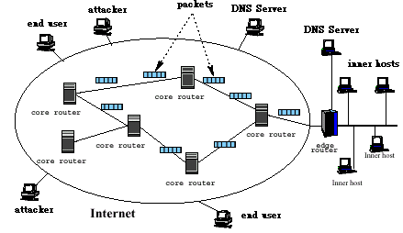
Network Architecture:
1

Slide 3
TCP/IP Protocol Suite

Slide 4
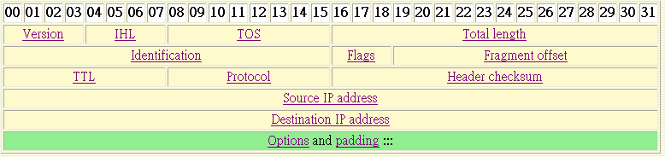
IP Header _{[networksorcery]}
Specifies the length of the IP packet header in 32 bit words. The minimum value for a valid header is 5.

Slide 5
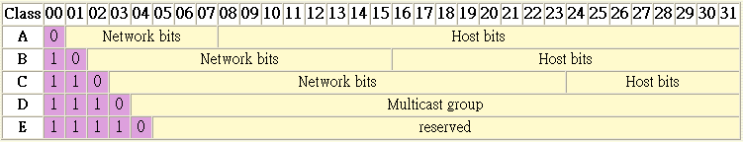
Classes of IP addresses
Class A: 1.0.0.0 ~ 127.255.255.255
Class B: 128.0.0.0 ~ 191.255.255.255
Class C: 192.0.0.0 ~ 223.255.255.255
Class D: 224.0.0.0 ~ 239.255.255.255

Slide 6
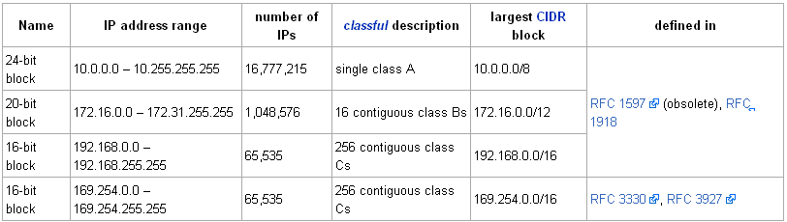
Private Network
In Internet terminology, a private network is a network that uses RFC 1918 IP address space.
Computers may be allocated addresses from this address space when it's necessary for them to communicate with other computing devices on an internal (non-Internet) network but not directly with the Internet.

Slide 7


ICMP Header

Slide 8
Function of ICMP
ICMP messages are sent in several situations:
  for example,
    when a datagram cannot reach its destination
    when the gateway does not have the buffering capacity to forward a datagram
    when the gateway can direct the host to send traffic on a shorter route
The Internet Protocol is not designed to be absolutely reliable. The purpose of these control messages is to provide feedback about problems in the communication environment, not to make IP reliable.

Slide 9
Properties of ICMP Packets
There are still no guarantees that a datagram will be delivered or a ICMP control message will be returned.
Some datagrams may still be undelivered without any report of their loss. The higher level protocols that use IP must implement their own reliability procedures if reliable communication is required.
The ICMP messages typically report errors in the processing of datagrams. To avoid the infinite regress of messages about messages etc., no ICMP messages are sent about ICMP messages.

Slide 10
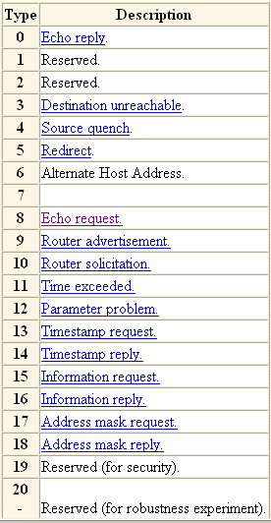
ICMP Types

Slide 11
Routing Table
Router
Interface card
eth1
eth0
180.2.3.*
180.2.3.9
172.16.55.100
Internet
172.16.55.0
R
172.16.55.36
R
172.16.55.1
172.16.50.0
H
172.16.50.12
R : Router
H : Host
172.16.55.3

Slide 12
A Routing Table Used in the Previous Slide
Destination
Gateway
Genmask
Flags
Metric
Ref
Use
I_face
172.16.55.3
0.0.0.0
255.255.255.255
UH
eth0
172.16.55.0
0.0.0.0
255.255.255.0
U
eth0
172.16.50.0
172.16.55.36
255.255.255.0
UG
eth0
180.2.3.0
0.0.0.0
255.255.255.0
U
eth1
127.0.0.0
0.0.0.0
255.0.0.0
U
lo
0.0.0.0
172.16.55.1
0.0.0.0
UG
eth0
U : useful
H : to a single host
G : to a gateway
default
Flag
A destination IP performs and operation with the Genmask and compares the result with the Destination field. The first interface matching will be used to transfer the packet.

Slide 13
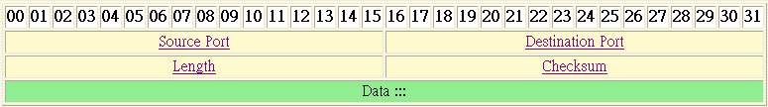
UDP Header Format
The length in bytes of the UDP header and the encapsulated data. The minimum value for this field is 8.

Slide 14
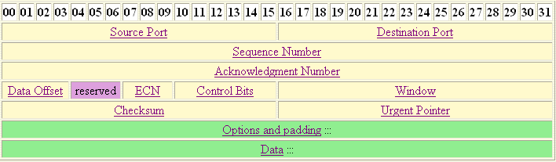
TCP Header Format

Slide 15
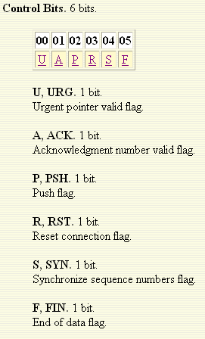
Control Bits in a TCP Header

Slide 16
TCP Sliding Windows
For each TCP connection each hosts keep two Sliding Windows,
  send sliding window, and
  receive sliding window
to make sure the correct transmission of Traffic between the send and receiver.
Each byte sent from the sender to the receiver has a unique sequence number associated with it.

Slide 17
Three-way Handshaking
Client
Server
SYN (seq# = x)
SYN / ACK
ack# = x+1
seq# = y
ACK (seq# = x ; ack# = y+1)

Slide 18
Making a TCP Connection through a Socket
Server
Client
Socket ()
Socket ()
Bind ()
Connection ()
Listen ()
Write ()
Data request
Accept ()
Read ()
Block until connection request from client
Read ()
Data reply
Process request
Write ()

Slide 19
ARP
The Address Resolution Protocol is used by each host on an IP network to map local IP addresses to hardware addresses or MAC addresses.
Here is a quick look at how this protocol works.
  Say that Host A (IP address 192.168.1. 100) wants to send data to Host B (IP address 192.168.1.250). No prior communications have occurred between Hosts A and B, so the ARP table entries for Host B on Host A are empty.
  Host A broadcasts an ARP request packet indicating that the owner of the IP address 192.168.1.250 should respond to Host A at 192.168.1.100 with its MAC address. The broadcast packet is sent to every machine in the network segment, and only the true owner of the IP address 192.168.1.250 should respond.
  All other hosts discard this request packet, but Host A receives an ARP reply packet from Host B indicating that its MAC address is BB:BB:BB:BB:BB:BB. Host A updates its ARP table, and can now send data to Host B.

Slide 20
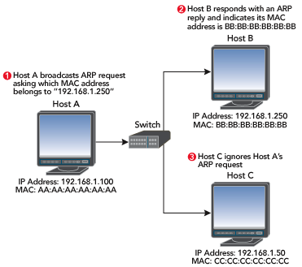
Finding the Owner of a MAC Address

Slide 21
ARP Table Modifications
However Host A doesn’t know that Host B really did send the ARP reply.
In the previous example, attackers could spoof an ARP reply to Host A before Host B responded, indicating that the hardware address E0:E0:E0:E0:E0:E0 corresponds to Host B's IP address.
  Host A would then send any traffic intended for Host B to the attacker, and the attacker could choose to forward that data (probably after some tampering) to Host B.

Slide 22
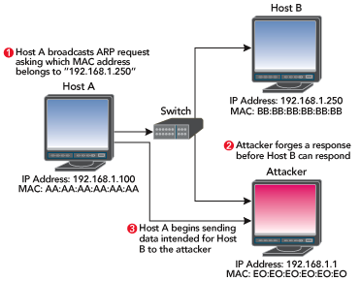
Spoofed Reply

Slide 23
TCP Session Hijacking

Slide 24
TCP Session Hijacking
TCP session hijacking is when a hacker takes over a TCP session between two machines.
Since most authentication only occurs at the start of a TCP session, this allows the hacker to gain access to a machine.

Slide 25
Categories of TCP Session Hijacking
Based on the anticipation of sequence numbers there are two types of TCP hijacking:
  Man-in-the-middle Attack (MA)
  Blind Hijack

Slide 26
Man-in-the-middle Attack (MA)
A hacker can also be "inline" between B and C using a sniffing program to watch the sequence numbers and acknowledge numbers in the IP packets transmitted between B and C. And then hijack the connection.
This is known as a "man-in-the-middle attack".

Slide 27
Man in the Middle Attack Using Packet Sniffers
This technique involves using a packet sniffer to intercept the communication between client and the server.
Packet sniffer comes in two categories:
  Active sniffers
  Passive sniffers.

Slide 28
Passive Sniffers
Passive sniffers monitors and sniffs IP packets from a network having same collision domain (i.e. network with a hub, as all packets are broadcasted on each port of the hub.)

Slide 29
Active Sniffers
One way of doing so is to change the default gateway of the client’s machine so that it will route its packets via the hijacker’s machine.
This can be done by ARP spoofing (i.e. by sending malicious ARP packets mapping its MAC address to the default gateways IP address so as to update the ARP cache on the client, to redirect the traffic to hijacker).

Slide 30
Blind Hijacking _{[Shray Kapoor]}
If you are NOT able to sniff the packets and guess the correct sequence number expected by server, you have to implement “Blind Session Hijacking.’’
You have to brute force 4 billion combinations of sequence number which will be an unreliable task.

Slide 31
Ways to Suppress a Hijacked Host to Send Packets
A common way is to execute a Denial-of-Service (DoS) attack against one end-point to stop it from responding.
  This attack can be either
    against the machine to force it to crash
    or
    against the network connection to force heavy packet loss.
Send packets with commands that request the recipient not to send back response_{[rfc857]}.

Slide 32
MA Simulation

Slide 33
TCP Session Hijacking
a
100
b
Host A
Host B
c
600
d
e
f
g
Sending window
h
Receiving window

Slide 34
TCP Session Hijacking
a
b
Host A
Host B
c
d
e
f
g
Sending window
h
Receiving window

Slide 35
TCP Session Hijacking
a
b
Host A
Host B
c
d
e
f
g
attacker
Sending window
h
Receiving window

Slide 36
TCP Session Hijacking
a
IP pkt
b
Host A
Host B
c
d
e
f
g
attacker
Sending window
h
Receiving window
Host A closes its socket due to receiving strange response from Host B

Slide 37

TCP Session Hijacking
a
RST
b
IP pkt
Host A
Host B
c
d
e
f
g
attacker
Sending window
h
Receiving window

Slide 38
Solution

Slide 39
TCP Session Hijacking
Send forged packets to both end hosts and suppress end hosts to create output and change both hosts’ receiving windows
a
b
Host A
Host B
c
Simulated Host B’s
sending window
No change
d
No change
e
f
Simulated Host A’s
sending window
g
Sending window
h
IP pkt
Receiving window
IP pkt
attacker

Slide 40
TCP Session Hijacking:
Then attackers take care of packets sent by both hosts.
a
b
Host A
Host B
c
Simulated A’s
Receiving window
d
e
Simulated B’s
Receiving window
f
g
Sending window
h
Receiving window
attacker

Slide 41
How to detect the above attack?

Slide 42
TCP Session Hijacking:
However Host B will receive packets from Host A with ACK number larger than its sending window.
a
b
Host A
Host B
c
d
e
f
g
Sending window
h
Receiving window
attacker

Slide 43
TCP Session Hijacking Tools
T-Sight
Hunt
Juggernaut
… and so on.

Slide 44
TCP ACK Packet Storms
Assume that the attacker has forged the correct packet information (headers, sequence numbers, and so on) at some point during the session.
  When the attacker sends to the server-injected session data, the server will acknowledge the receipt of the data by sending to the real client an ACK packet.
    This packet will most likely contain a sequence number that the client is not expecting, so when the client receives this packet, it will try to resynchronize the TCP session with the server by sending it an ACK packet with the sequence number that it is expecting.
    This ACK packet will in turn contain a sequence number that the server is not expecting, and so the server will resend its last ACK packet.
    This cycle goes on and on and on, and this rapid passing back and forth of ACK packets creates an ACK storm.

Slide 45
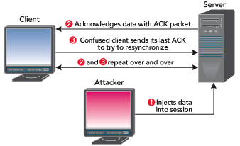
ACK Storm

Slide 46
Countermeasures (by normal users) - Encryption
The most effective is encryption such as IPSec.
  Internet Protocol Security has the ability to encrypt your IP packets based on
    a Pre-Shared Key
    or
    with more complex systems like a Public Key Infrastructure PKI.
  This will also defend against many other attack vectors such as sniffing.
  The attacker may be able to passively monitor your connection, but they will not be able to read any data as it is all encrypted.

Slide 47
Countermeasures (by attackers)
Don’t think that IPSec is the panacea to all your ills, there are IPSec cracking tools available on the internet that will attempt to guess the PSK and decrypt packets.

Slide 48
Countermeasures – Encrypted Application
Other countermeasures include encrypted applications like ssh (Secure SHell, an encrypted telnet) or ssl (Secure Sockets Layer, HTTPS traffic).
  Again this reflects back to using encryption, but a subtle difference being that you are using the encryption within an application.
  Be aware though that there are known attacks against ssh and ssl.
  OWA, Outlook Web Access uses ssl to encrypt data between an internet client browser and the Exchange mail server, but tools like Cain & Abel can spoof the ssl certificate and mount a Man-In-The-Middle (MITM) attack and decrypt everything!

Slide 49
Handling TCP ACK Storms
Attackers can also use ARP packet manipulation to quiet TCP ACK storms, which are noisy and easily detected by devices such as intrusion detection system (IDS) sensors.
Session hijacking tools such as hunt accomplish this by sending unsolicited ARP replies. Most systems will accept these packets and update their ARP tables with whatever information is provided.
  In our Host A/Host B example, an attacker could send Host A a spoofed ARP reply indicating that Host B's MAC address is something nonexistent (like C0:C0:C0:C0:C0:C0), and send Host B another spoofed ARP reply indicating that Host A's MAC address is also something nonexistent (such as D0:D0:D0:D0:D0:D0). Any ACK packets between Host A and Host B that could cause a TCP ACK storm during a network-level session hijacking attack are sent to invalid MAC addresses and lost.

Slide 50
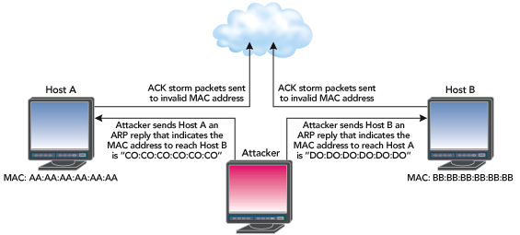
Stopping a TCP ACK Storm

